Slide 1
Machine Learning project
(AI)

Slide 2
Group Names: 1- Shahd Mohamed Mohamed Bakry 2- Omnia Arafa Mohamed 3- Hassan Mohamed Hassan 4- Ahmed Amin Abd Elnaby 5- Ahmed Ehab Hussein Sakr

Slide 3
01
Data Exploration
(AI)

Slide 4
Explore data means : To know that the data if has missing values or has no wrong formatting or duplicated row/columns

Slide 5
Introduction about data:
The data talk about the students performance from the United States.
This data set consists of the marks secured by the students in various subjects.
Data consists of 8 columns and 1000 rows

Slide 6
What is the target of the data?
The target of a data set is the variable that you are trying to predict or explain. It is the dependent variable in a statistical model.
To understand the influence of the parents background, test preparation etc. on students performance
To know how many students are good to enter the collage with there writing , reading and math score
Also to see if the gender/parental level of education/lunch/test preparation course affect on there score or not

Slide 7
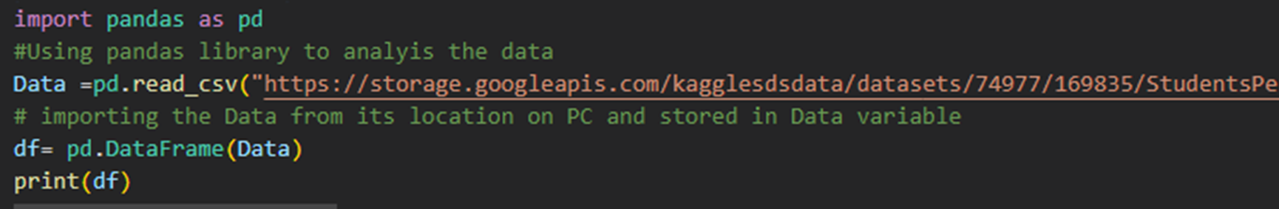
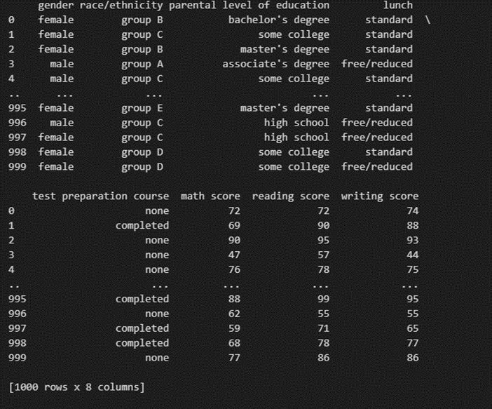
Codes to print data set:
Output:

Slide 8
Columns Name
Frist -> gender its refers to the characteristics of women, men, girls and boys that are socially constructed. Percentage = (female are 52%) & (male are 48%)
Second -> race/ethnicity they are used to categorize sections of the population. Race refers to dividing people into groups, often based on physical characteristics and they are divided into groups (A,B,C,D,E) (group C are 32%) , (group D are 26%) , (other are 42%)
Third -> parental level of is important because it provides caregivers with knowledge, resources, and support to develop parenting skills to enhance child and family well-being (some college are 23%) , (associate's degree are 22%) , (other are 55%)
Fourth -> lunch school lunch is critical to student health and well-being, especially for low-income students and ensures that students have nutrition they need throughout the day to learn. (Standard are 65%) , (free/reduced are 36%)

Slide 9
Columns Name
Fifth -> test preparation courses are important for students because they can help students build A best-fit college list. One of the most important parts of the college preparation process is building A balanced list of target, reach, and likely colleges. Selecting the schools for this list depends on A variety of factors, one being A student’s chances of admission based on grades and test scores (none are 64%) , (completed are 36%)
Sixth -> math score the score can be used to determine the student’s level of understanding of math concepts and skills.
Seventh -> reading score the score can be used to determine the student’s level of understanding of reading concepts and skills.
Eight -> writing score the score is usually based on the number of correct answers given by the student.

Slide 10
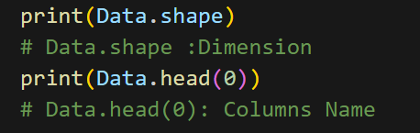
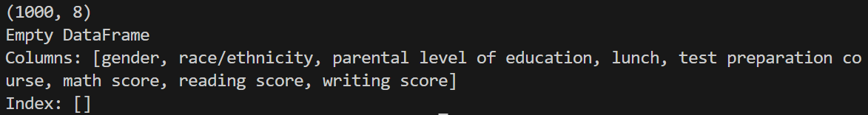
Code of dimensions & columns names :
Output:

Slide 11
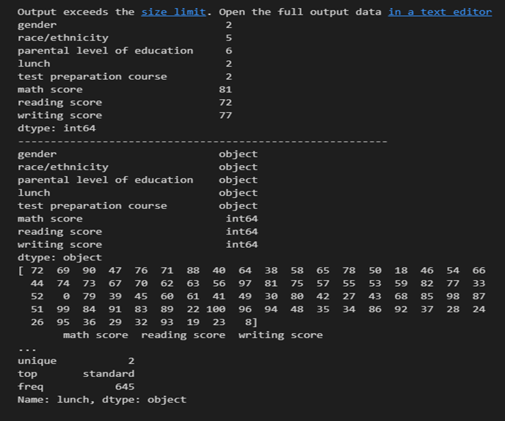
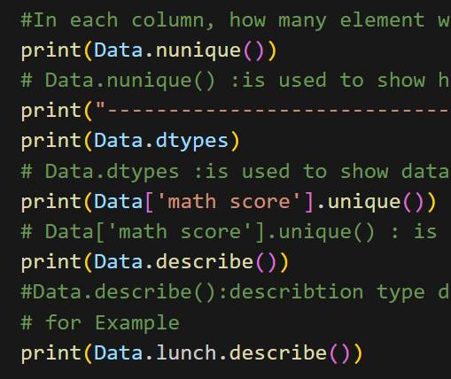
Code of types & describe the data:
Output:

Slide 12
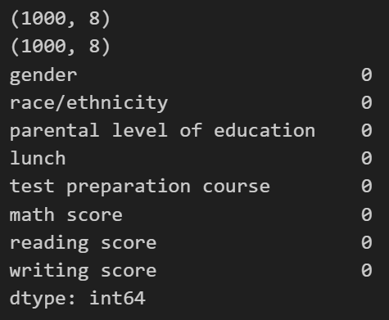
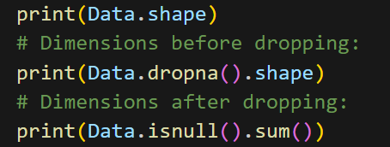
Code of deleting the row or column:
Output:

Slide 13
02
Data Visualization
(AI)

Slide 14
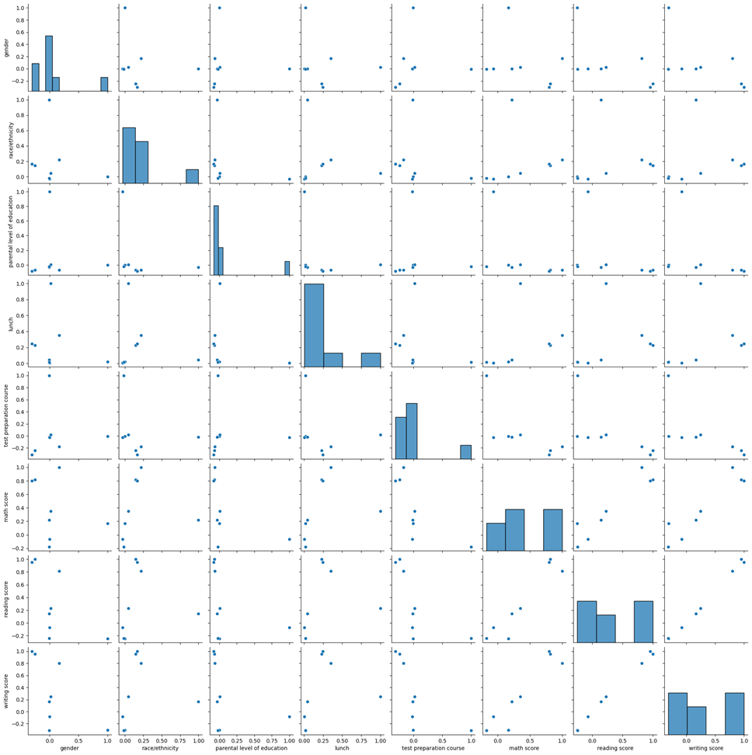
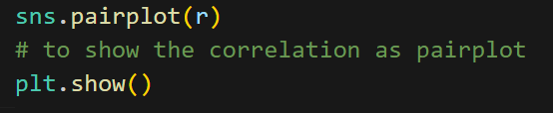
Code: 1- Pair plot
Output:

Slide 15
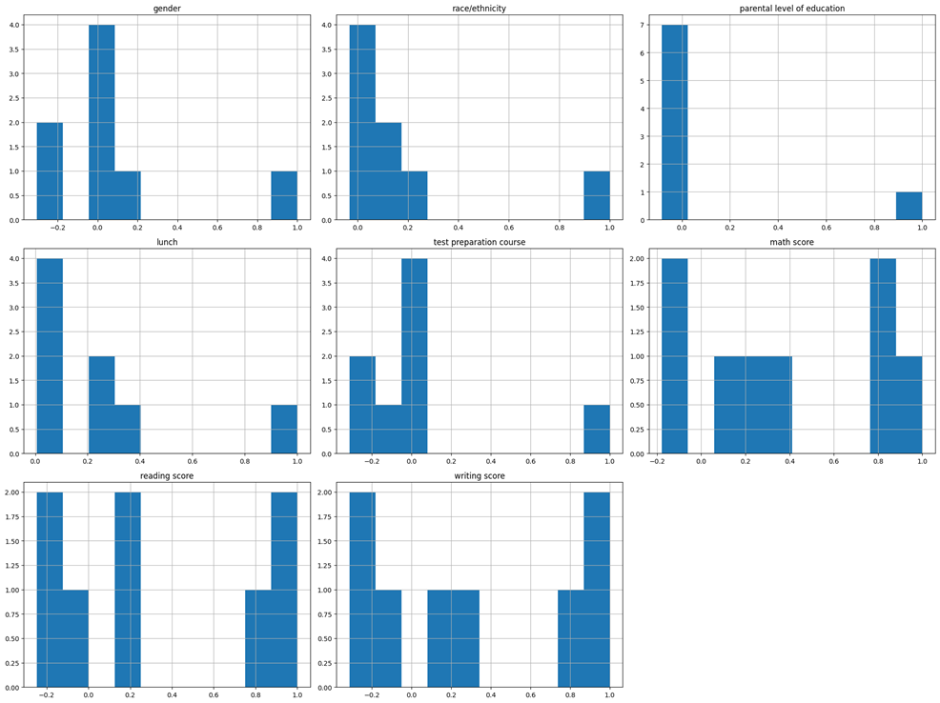
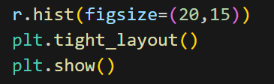
Code: 2- Histogram
Output:

Slide 16
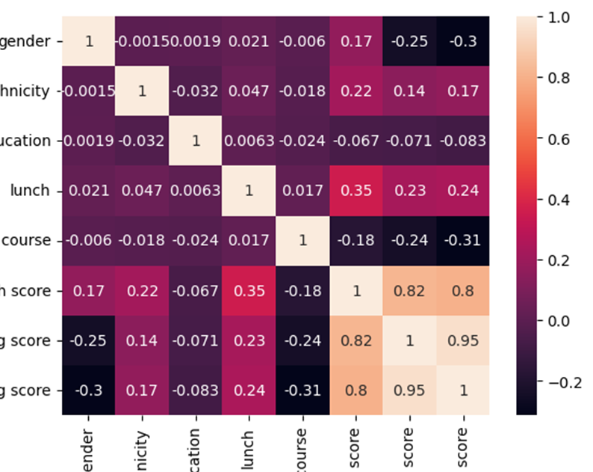
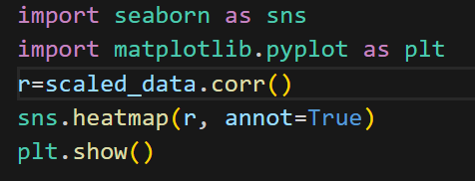
Code: 3- Heat map
Output:
It will show the correlation between the columns in colors and/or values instead of values only

Slide 17
Table of Correlation
Correlation type: | gender | race/ethnicity | parental level of education | lunch | test preparation course | math score | reading score | writing score
Positive | math score | math score reading score writing score |  | math score reading score writing score |  | Gender Race/ethnicity Lunch writing score reading score | Gender Race/ethnicity Lunch math score writing score | math score reading score Race/ethnicity Lunch
Negative | writing score reading score |  |  |  | math score reading score writing score | test preparation course | Test preparation Course | Gender Test preparation Course Parental level of education
No | race/ethnicity parental level of education lunch test preparation course | parental level of education lunch test preparation course gender | Gender Race/ethnicity Lunch Test preparation Course Math score Reading score Writing score | Gender Race/ethnicity Test preparation Course Parental level of education | race/ethnicity parental level of education lunch gender | parental level of education | Parental level of education

Slide 18
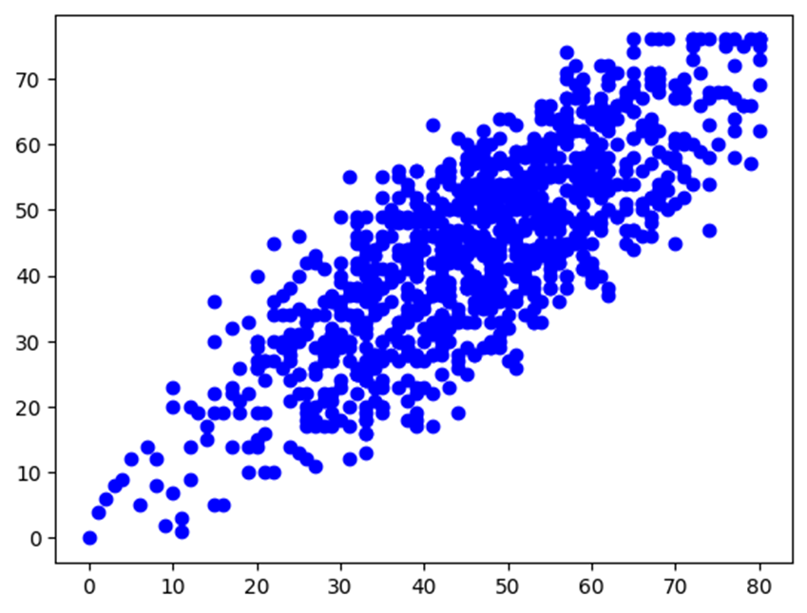
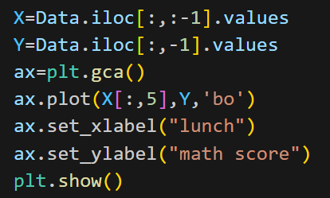
Code: 4- Scatter
Output:

Slide 19
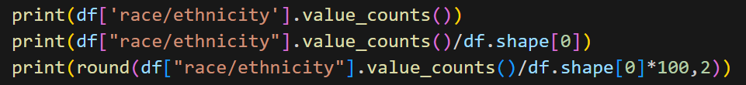
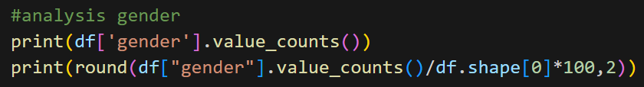
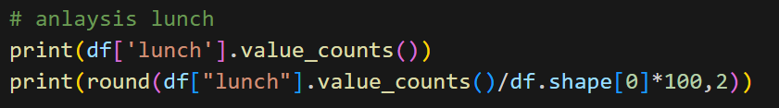
Before draw Pie plot we need to analyze :

Slide 20
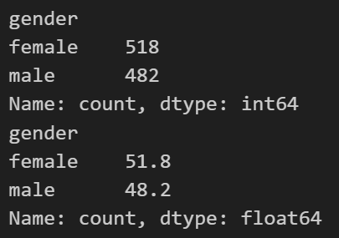
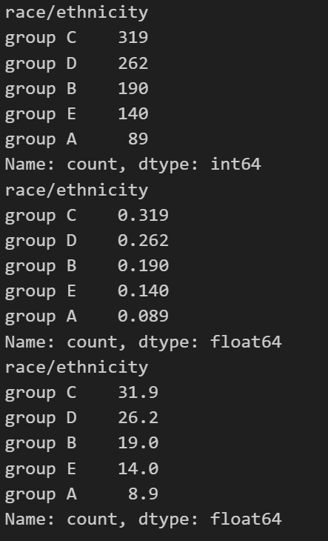
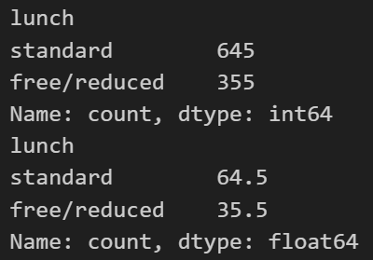
Outputs:

Slide 21
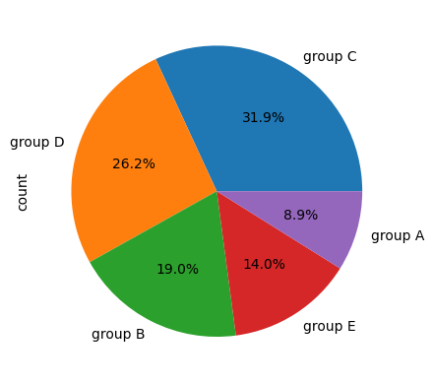
Code: 5- Pie Plot
Output:

Slide 22
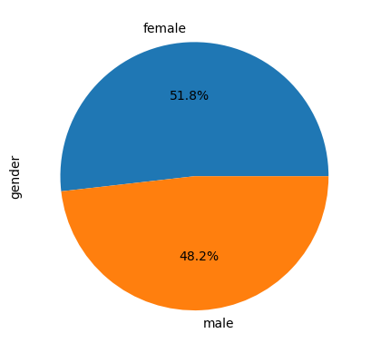
Code: 5- Pie Plot
Output:

Slide 23
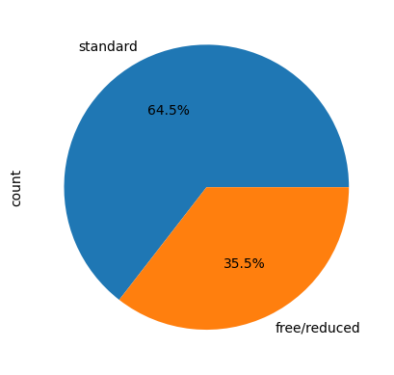
Code: 5- Pie Plot
Output:

Slide 24
03
Descriptive Analysis
(AI)

Slide 25
Statisics in python :
This library help us to using statistics in python ‘statistics’ and this calculatations for only numerical columns which are ‘ writing , reading & math scores ’
(a) Mean, Mode & Median
They are measures of central tendency in statistics. They help organize and compare data sets. Mean is the average value of a data set. Median is the middle value of a data set when the values are arranged from smallest to largest. Mode is the most repeated value in a data set.
(b) Variance & Standard deviation
Variance is a measure of how data points vary from the mean, whereas standard deviation is the measure of the distribution of statistical data.

Slide 26
Statisics in python :
(c) Box plot
It is a type of chart that shows the distribution of numerical data and skewness. It displays the minimum, maximum, median, and quartiles (or percentiles) of a data set. A box plot is useful when you want to compare data between multiple groups, show the variability or dispersion of the data or identify outliers.
(d) Z-score
It is a statistical measurement that compares the mean and standard deviation of a sample to the population. It is used to determine how many standard deviations an observation is from the mean. The formula for calculating the z-score is (x-μ)/σ where x is the observation, μ is the population mean, and σ is the population standard deviation.

Slide 27
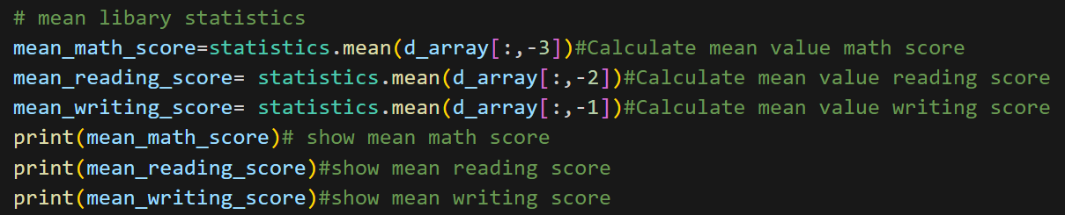
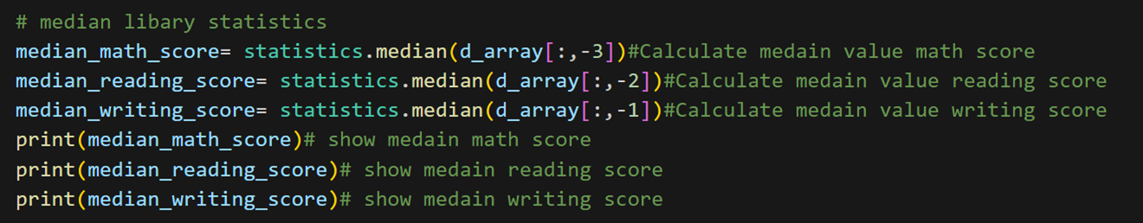
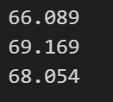
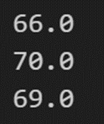
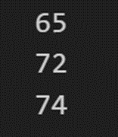
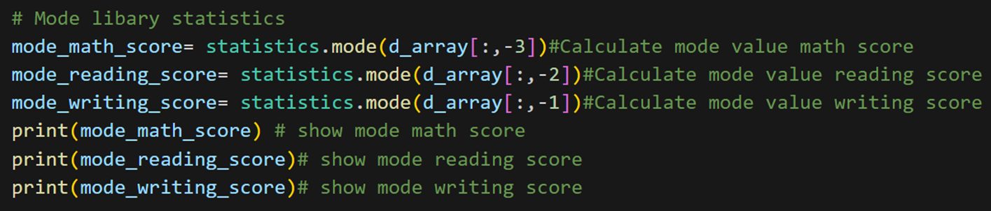
Get mean , median & mode :
Output:

Slide 28
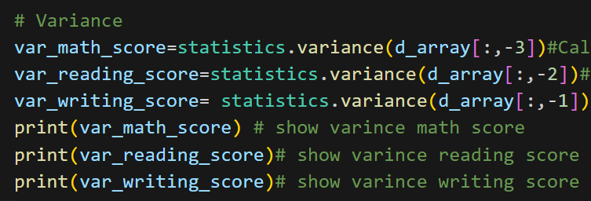
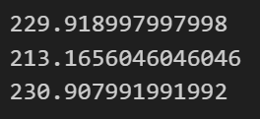
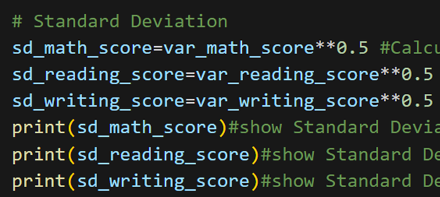
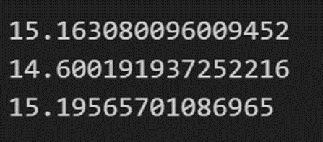
Get variance & Standard deviation :
Outputs:

Slide 29
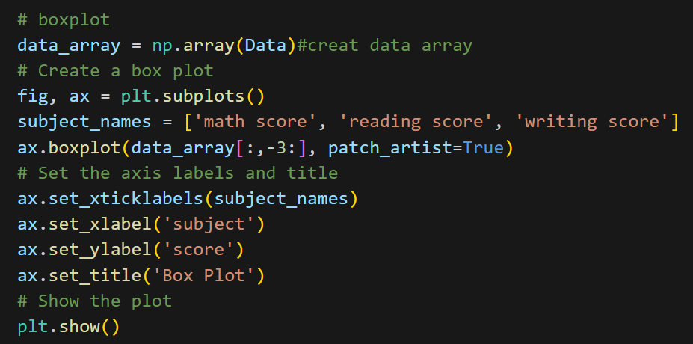
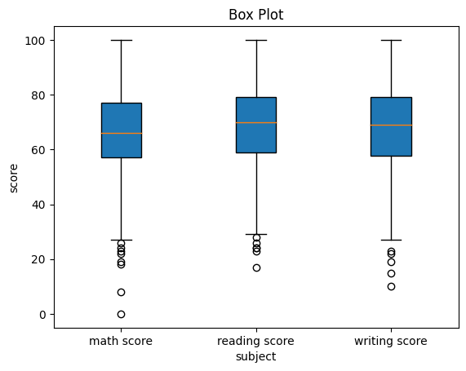
Code of box pot :
Output:

Slide 30
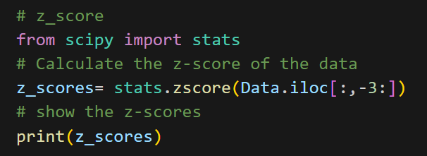
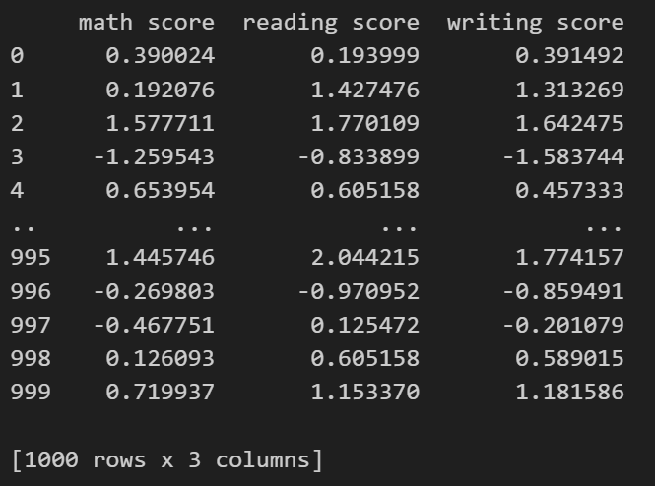
Code of z-score :
Output:

Slide 31
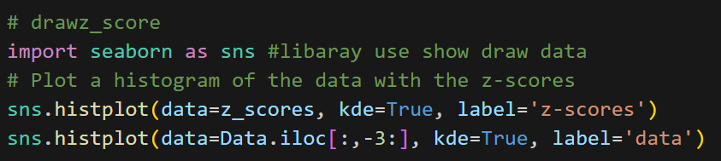
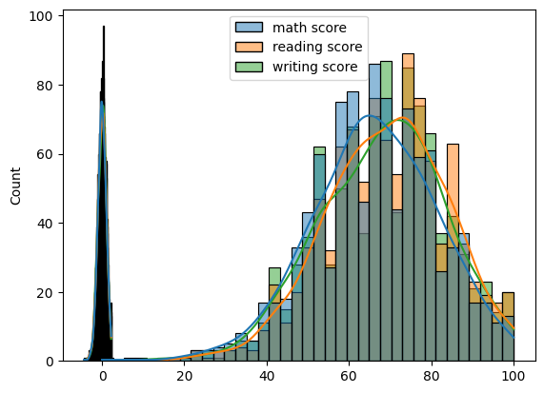
Code to show z-score:
Output:

Slide 32
04
Preprocessing & Modeling
(AI)

Slide 33
Meaning of the concepts :
(a) Data preprocessing
Is a process of transforming the raw data into a format that can be understood and used for analysis and modeling. Data preprocessing involves various techniques and methods for cleaning, filling in missing values, correcting errors, normalizing, and integrating data. The goal of data preprocessing is to improve the quality of the data and make it more suitable for the specific data mining or machine learning task.
(b) Data modeling
Is the process of creating a visual representation of data and its relationships to other data. It is used to define and analyze data requirements for information systems and business processes.

Slide 34
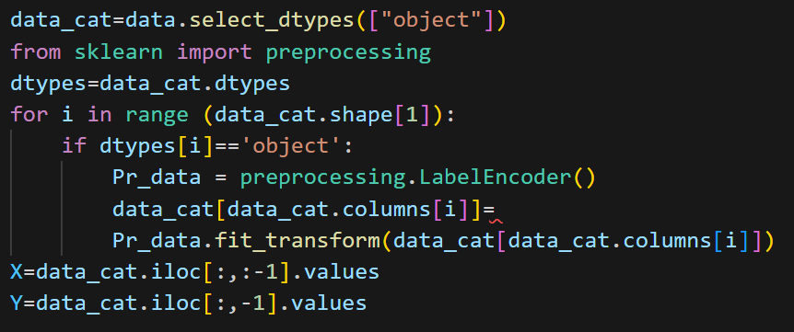
Encoding the data:
We split the data into categorical & continues data to apply techniques on it
Then encoding the categorical to change it to numbers

Slide 35
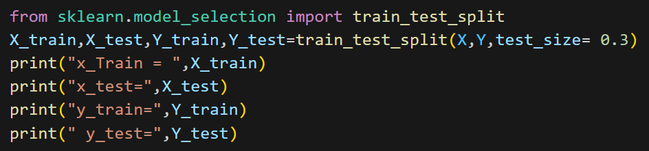
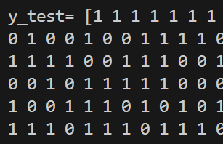
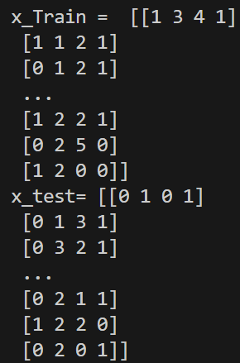
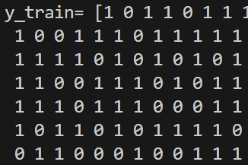
Split data into Train and test (categorical)
Output:

Slide 36
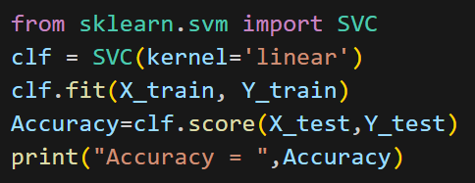

Then we should train our model by using the dataset. We will select Support Vector Machine with linear kernel as a suitable AI technique for our dataset and get accuracy as follows : but the accuracy of it = 65% which is not good enough ☹
Output:

Slide 37
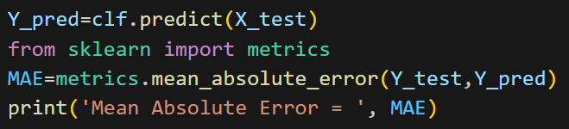
After split the data into train & test we should know the value of error that we have in this data, we use mean absolute error to know it and get the y predict from x_test:
Output:

Slide 38
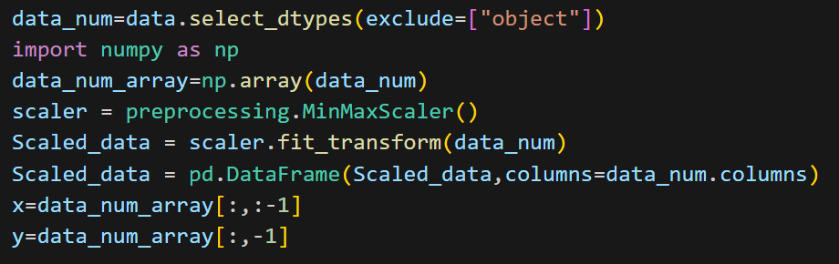
Scaling the data:
The continues data only need to scaling to be in range 0 and 1

Slide 39
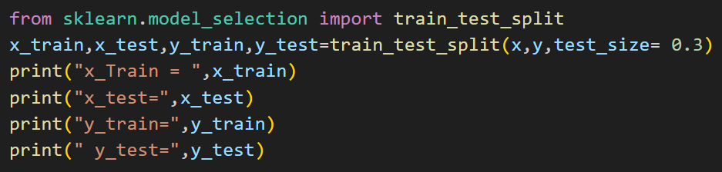




Split data into Train and test (continues)
Output:

Slide 40

Here we use linear model because is a numerical data and get the accuracy that equal 90% which is good ☺
Output:

Slide 41
05
Model Evaluation
(AI)

Slide 42
Meanig of Model Evaluation:
Is the process of assessing how well a model performs on a given dataset. It helps to determine whether the model is overfitting or under fitting the data. Overfitting occurs when the model is too complex and fits the training data too closely, while under fitting occurs when the model is too simple and does not fit the training data well enough.
There are several metrics used to evaluate machine learning models, including accuracy, precision, recall, F1 score, and ROC curve.

Slide 43


To determine the performance of the classification models for a given set of test data. For binary classification, confusion matrix consists from two rows and two columns. The two columns for true values while the rows for predicted values.
Output:

Slide 44


The cell values are: • True Positive (TP) • False Positive (FP) (Type-I error) • False Negative (FN) (Type-II error) • True Negative (TN)
Output:

Slide 45



Precision measures how often the model correctly predicts positive cases. Recall measures how often the model correctly identifies positive cases.
Output:

Slide 46



Accuracy measures how often the model makes correct predictions The F1 score is a weighted average of precision and recall.
Output:

Slide 47


The ROC curve is a graphical representation of the performance of a binary classifier And the AUC is calculated on the curve which is equal 0.50
Output:

Slide 48

Thank you

